Slide 1
TÜRK YEMEKLERİ
TURKISH MEALS

Slide 2
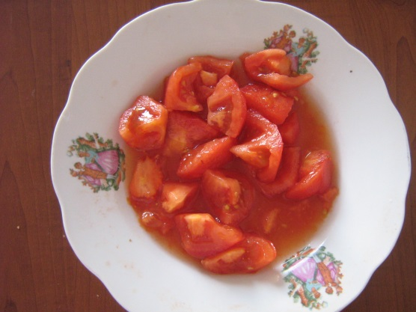
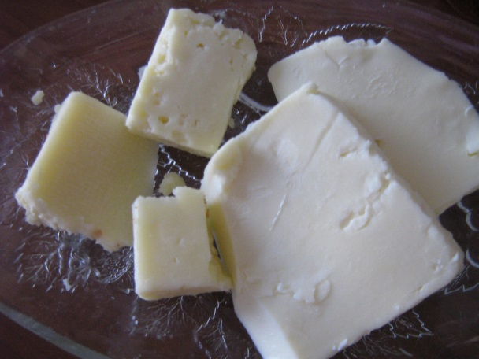
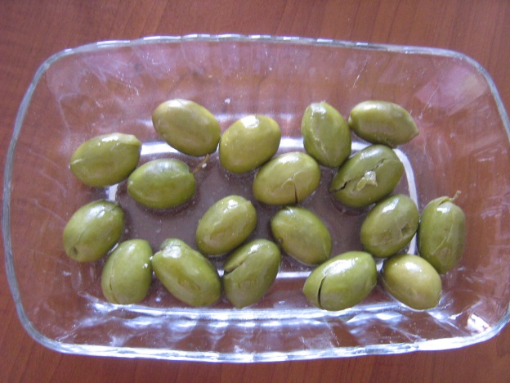
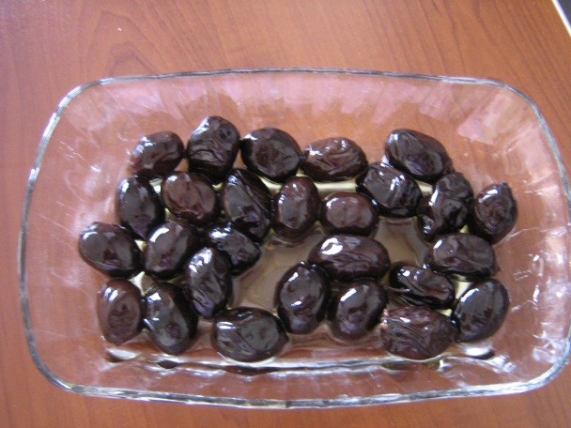
WEEK DAY BREAKFAST
BREAD
(EKMEK)
TOMATO
(DOMATES)
CHEESE
(PEYNİR)
GREEN OLIVES
(YEŞİL ZEYTİN)
BLACK OLIVES
(SİYAH ZEYTİN)

Slide 3
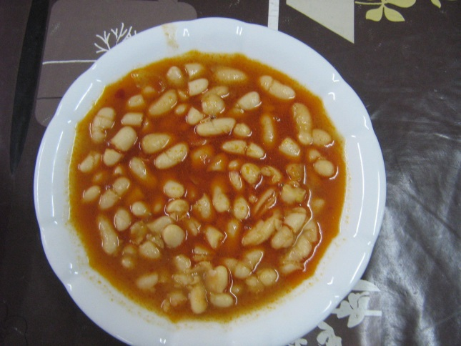
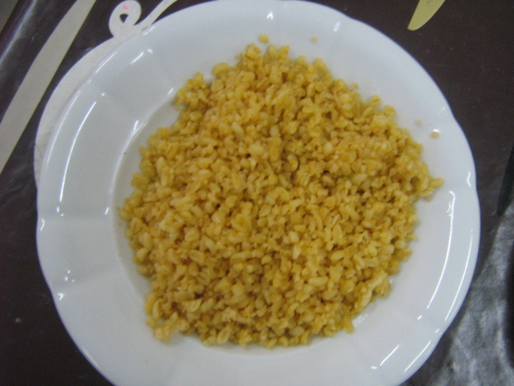
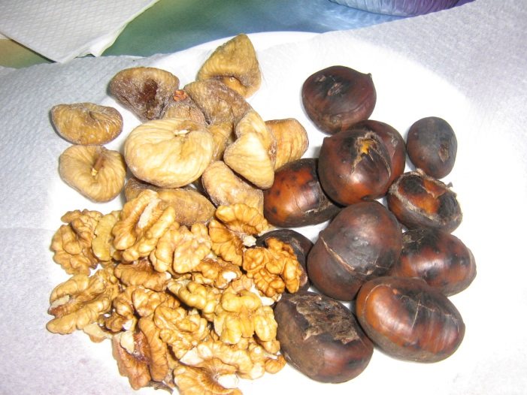
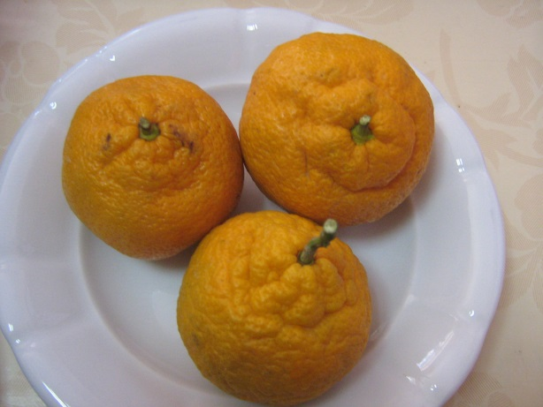
WEEK DAY LUNCH
WHITE BEANS
(KURU FASÜLYE)
CRACKED WHEAT
(BULGUR PİLAVI)
DRIED FIG (KURU İNCİR)
CHESTNUT
(KESTANE)
WALNUT
(CEVİZ)
TANGERINE
(MANDALİNA)

Slide 4
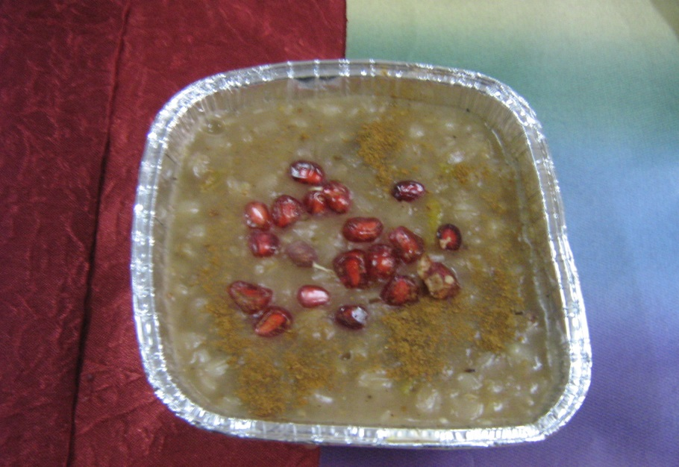
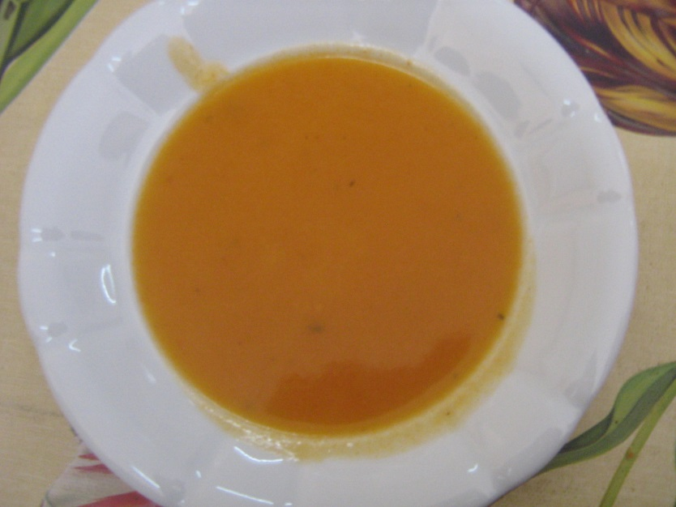
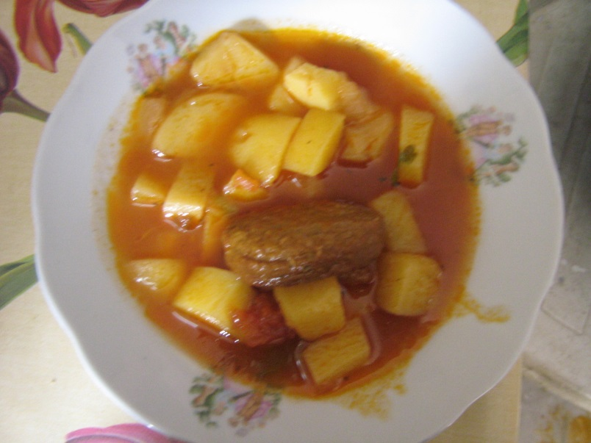
WEEK DAY DINNER
NOAH’S PUDDING
(AŞURE)
SOUP WITH SUNDRIED FOOD MADE OF CURD, TOMATO AND FLOUR
(TARHANA ÇORBASI)
POTATO WITH MEATBALL
(KÖFTELİ PATATES)

Slide 5
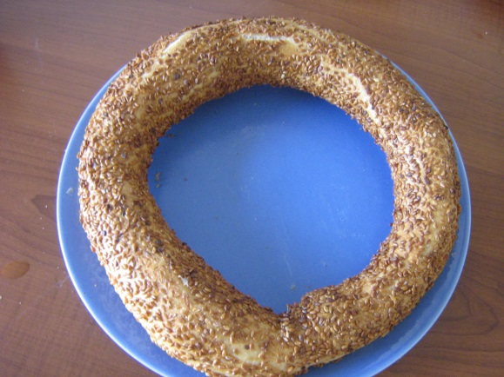
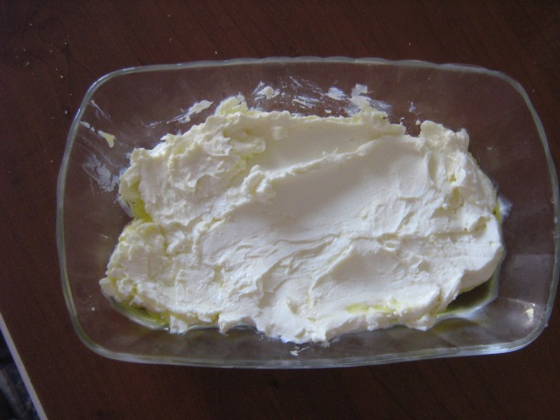
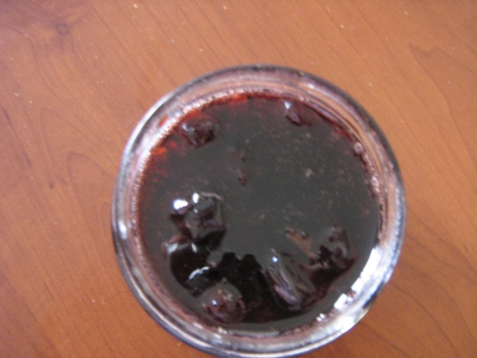
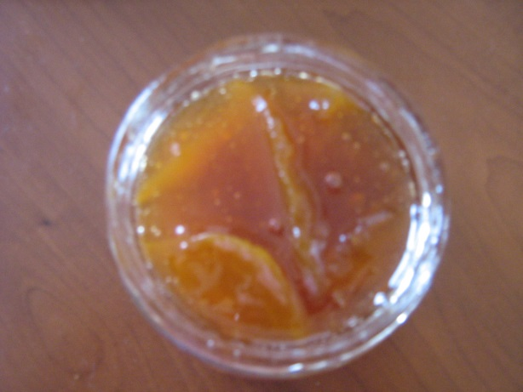
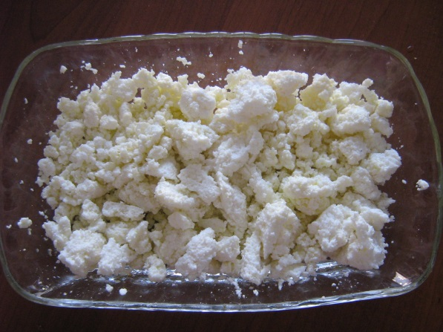
WEEKEND BREAKFAST
TURKISH BAGELS
(TÜRK SİMİTİ)
YOGHURT
(YOĞURT)
CHERRY JAM
(VİŞNE REÇELİ)
DRY COTTAGE CHEESE
(ÇÖKELEK)
PEACH JAM
(ŞEFTALİ REÇELİ)

Slide 6
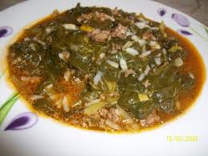
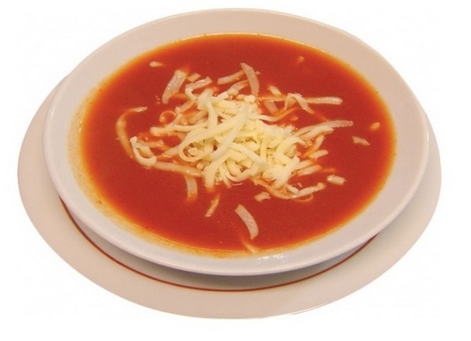
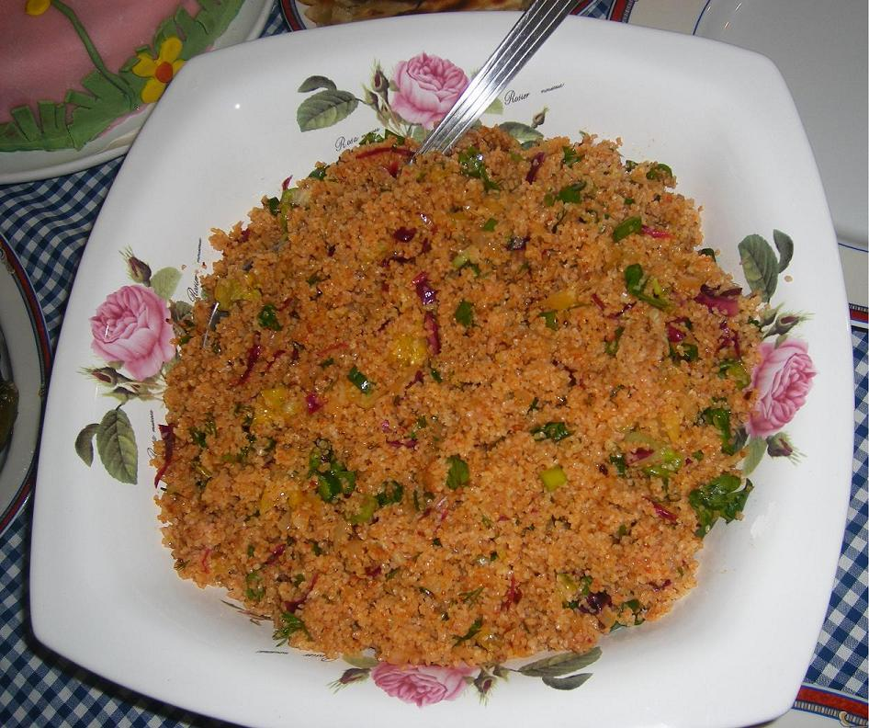
WEEKEND LUNCH
SPINACH WITH RICE
(PİRİNÇLİ ISPANAK)
TOMATO SOUP
(DOMATES ÇORBASI)
BURGHUL SALAD
(KISIR)

Slide 7
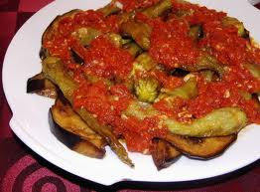
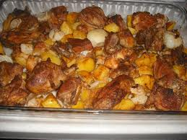
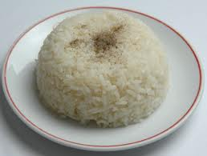
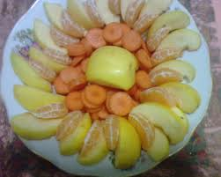
WEEKEND DINNER
FRIED EGGPLANT,
GREEN PEPPER
(KIZARMIŞ PATLICAN VE BİBER
CHICKEN WITH ONION AND POTATO
(SOĞANLI, PATATESLİ TAVUK)
RICE
(PİRİNÇ PİLAVI)
MIXED FRUITS; CARROT, ORANGE,APPLE,
QUINCE
(KARIŞIK MEYVE HAVUÇ, PORTAKAL, ELMA, AYVA

